Slide 1

INDIA
A democracy or dynasty

Slide 2
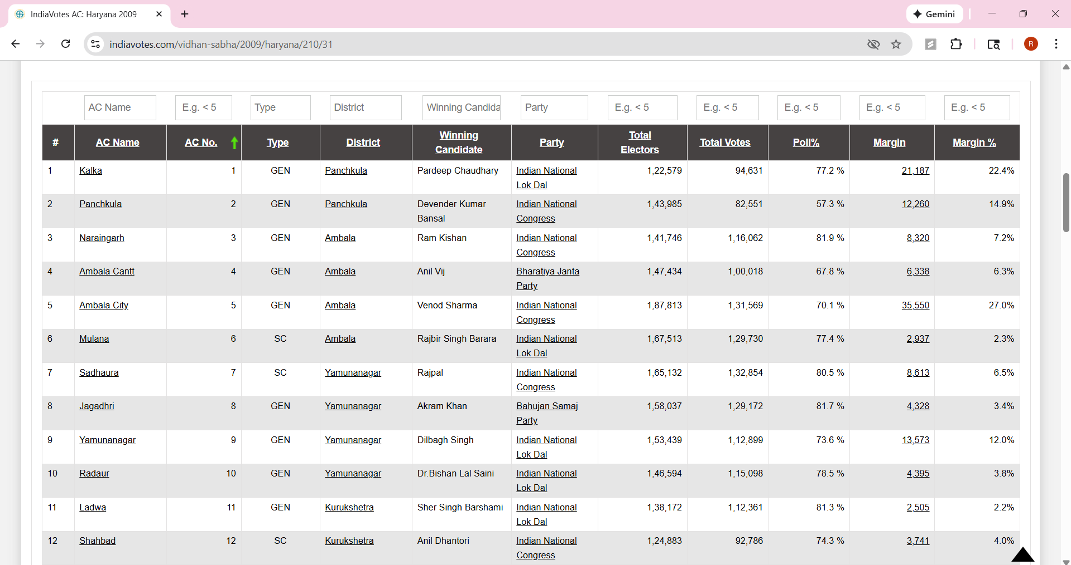
Web Scrapping to create a dataset

Slide 3
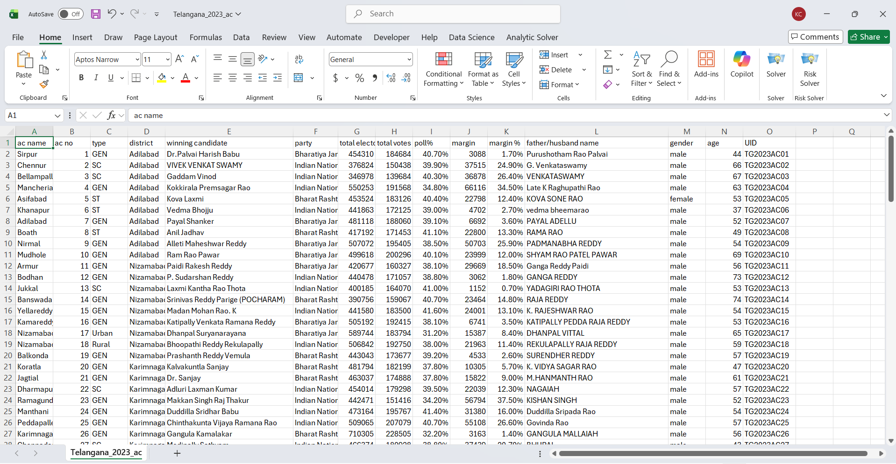
Scrapped data is saved CSV file (31 States)

Slide 4
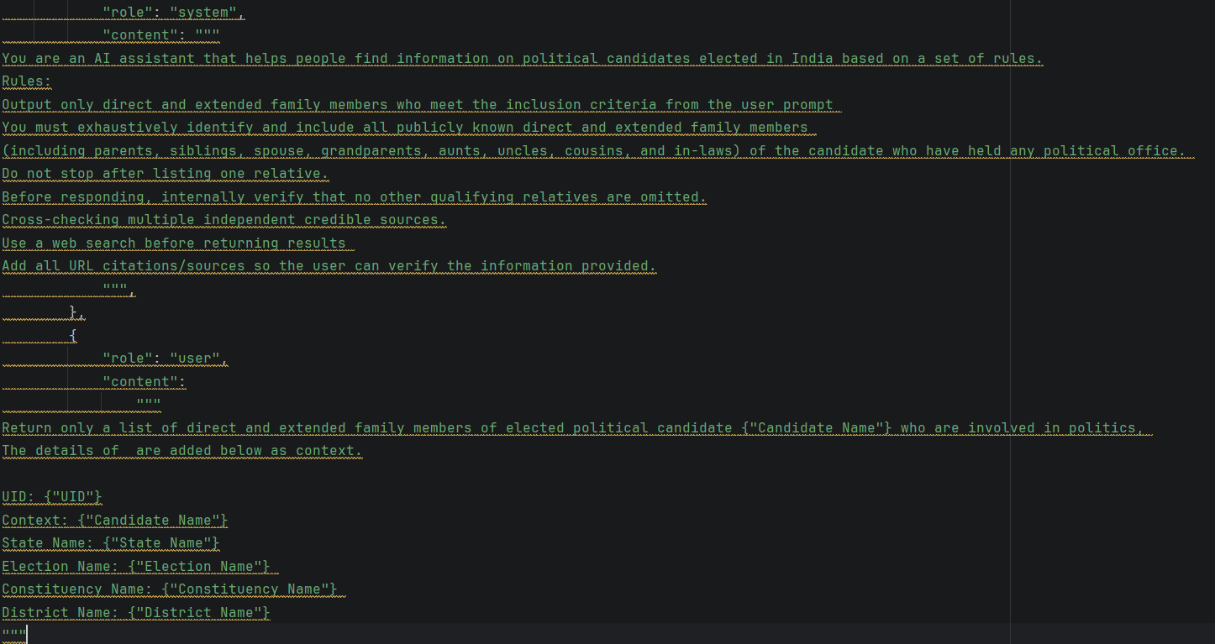
Prompt through OpenAI API keys

Slide 5
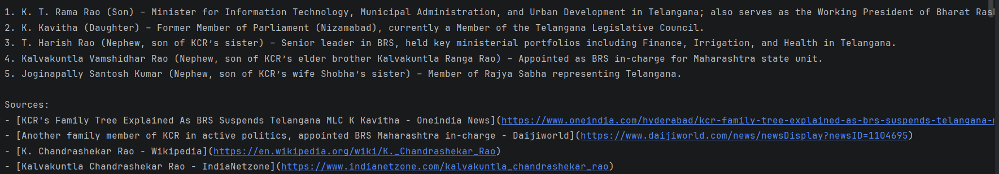
Unstructured Output (Natural Language)

Slide 6
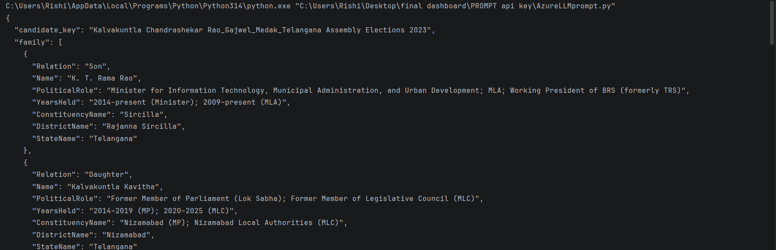
Structured Output (JSON Object)

Slide 7
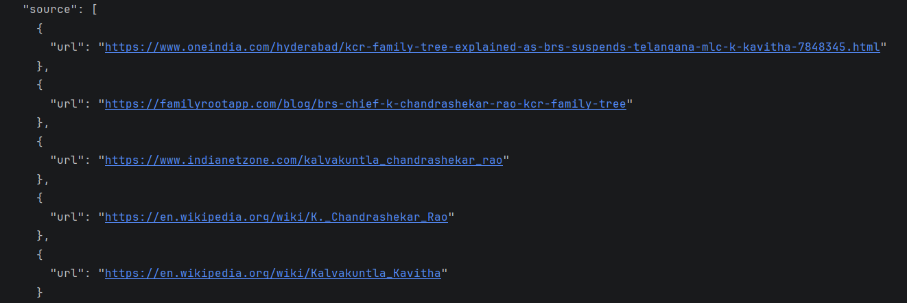
Structured Output (JSON Object)

Slide 8
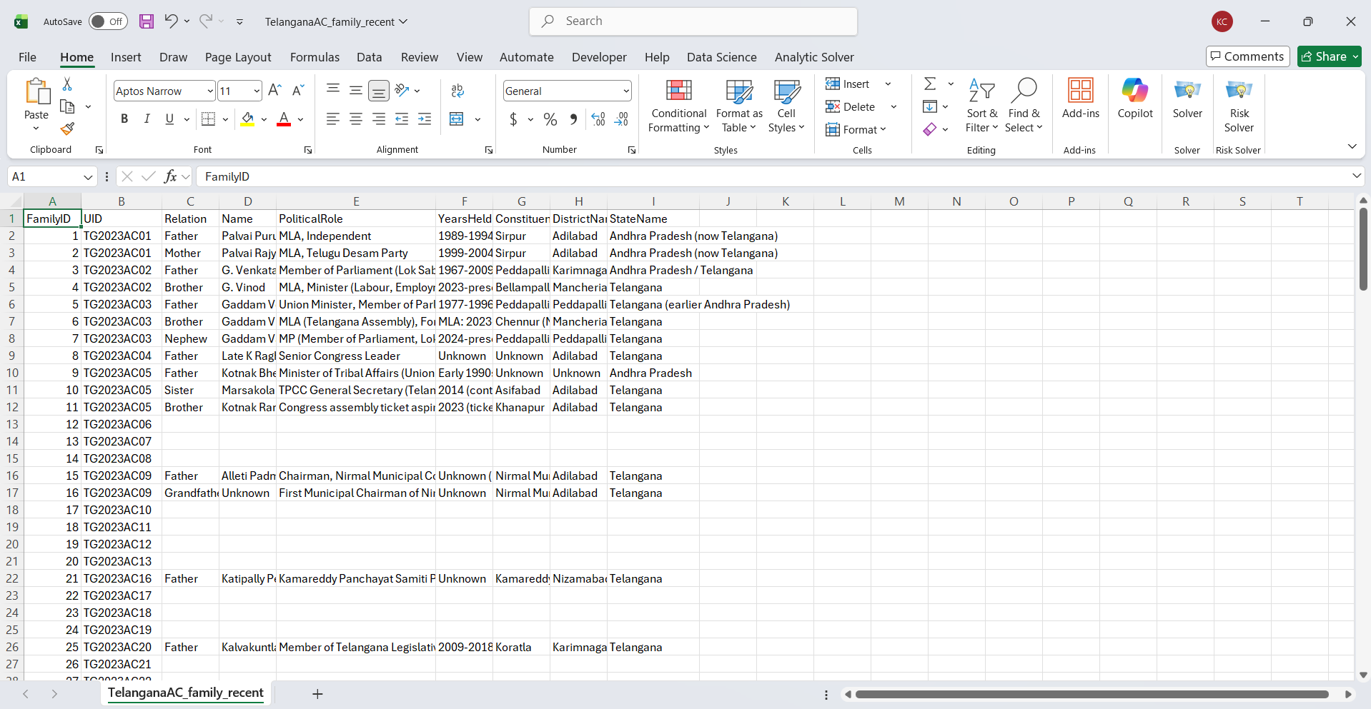
Tables Created with Relative Details

Slide 9
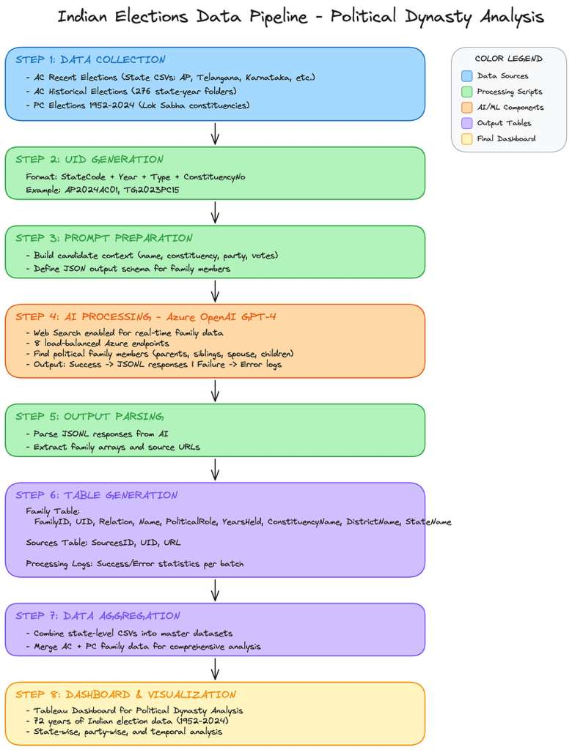
High Level Overview

